Slide 1
Intro to Redshift
Jason DeRose

Slide 2
What is Redshift?
Amazon Redshift is a fast, fully managed, petabyte-scale data warehouse that makes it simple and cost-effective to analyze all your data using your existing business intelligence tools.

Slide 3
What is Redshift?
A fork of (a really old version of) PostgreSQL (with many features disabled)
Traditional table-based relational database
Query with SQL via ODBC/JDBC drivers
Server managed by AWS (similar to RDS)
Column-oriented data storage
Parallel processing of queries

Slide 4

When to use Redshift instead of RDS
Redshift / Data Warehouses
General purpose SQL databases
- VS -
Ideal for OLAP (online analytical processing) of structured data
Large number of READS only, aggregating large volumes of data
Typically used internally (example: reporting historical monthly sales figures per product category)
Ideal for OLTP (online transaction processing) of structured data
Large number of READS and WRITES on individual records
Typically used by end-customer (example: placing an order for a product)

Slide 5
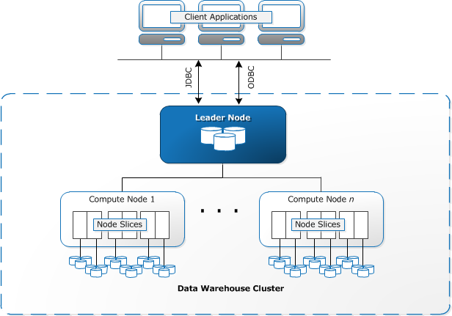
Parallel processing
Leader Node
Receives incoming queries
Derives execution plan
Merges results from compute clusters
Compute Node
Has own dedicated CPU, memory, and storage
Returns data it stores that belongs in the query result
Stores redundant data from other nodes

Slide 6
Current Pricing
Dense Compute Cluster
Node Size | vCPU | ECU | RAM (GiB) | Slices Per Node | Storage Per Node | N. VA Price Per Node | Node Range | Total Capacity
dc1.large | 2 | 7 | 15 | 2 | 160 GB SSD | $ 0.25 | 1–32 | 5.12 TB
dc1.8xlarge | 32 | 104 | 244 | 32 | 2.56 TB SSD | $ 4.80 | 2–128 | 326 TB
Dense Storage Cluster
Node Size | vCPU | ECU | RAM (GiB) | Slices Per Node | Storage Per Node | N. VA Price Per Node | Node Range | Total Capacity
ds2.xlarge | 4 | 13 | 31 | 2 | 2 TB HDD | $ 0.85 | 1–32 | 64 TB
ds2.8xlarge | 36 | 119 | 244 | 16 | 16 TB HDD | $ 6.80 | 2–128 | 2 PB
Reserved instance pricing available

Slide 7
Loading data (COPY)
The COPY command loads data in bulk in CSV, Avro or JSON from
S3
EMR
Custom SSH command
Or, directly from DynamoDB tables
Data can also be unloaded from other services (ie. kinesis firehose) to S3 and then COPY into Redshift
COPY can be automated from specific S3 location w/ Lambda

Slide 8
Loading data (INSERT)
Individual INSERT statements are slow. Multi-row or bulk inserts should be used instead.
Multi-row INSERT
insert into category_stage values
(default, default, default, default),
(20, default, 'Country', default),
(21, 'Concerts', 'Rock', default);
Bulk INSERT
insert into category_stage (select * from category);

Slide 9
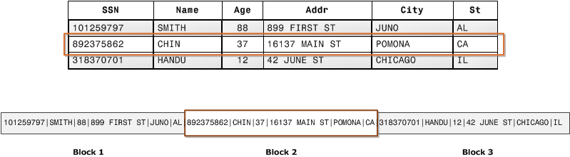
Row-oriented storage (traditional database)

Slide 10
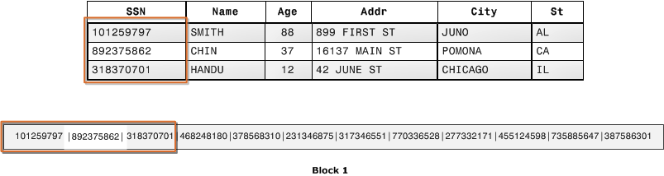
Column-oriented storage (Redshift, analytics-focused)

Slide 11
Compression
Reduces disk usage
Reduces I/O (improving query performance)
Types (set per column)
Raw
Byte-Dictionary
Delta
LZO
Mostly
Runlength
Text255 and Text32k
Zstandard
Example: Run-Length Encoding
Blue,Blue,Blue,Blue,Blue,Blue,Green,Green,Green
{6,Blue},{3,Green}
Compression type chosen automatically when empty table populated via COPY. Otherwise, ANALYZE COMPRESSION will suggest best choices.

Slide 12
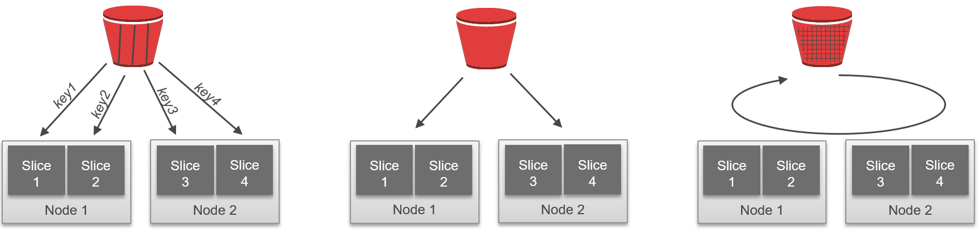
Table Distribution Styles
Distribution Key
All
Even
Same key to same location
(Larger tables)
All data on every node
(Smaller tables)
Round robin distribution
(Tables not participating in JOINs or GROUP BYs)

Slide 13
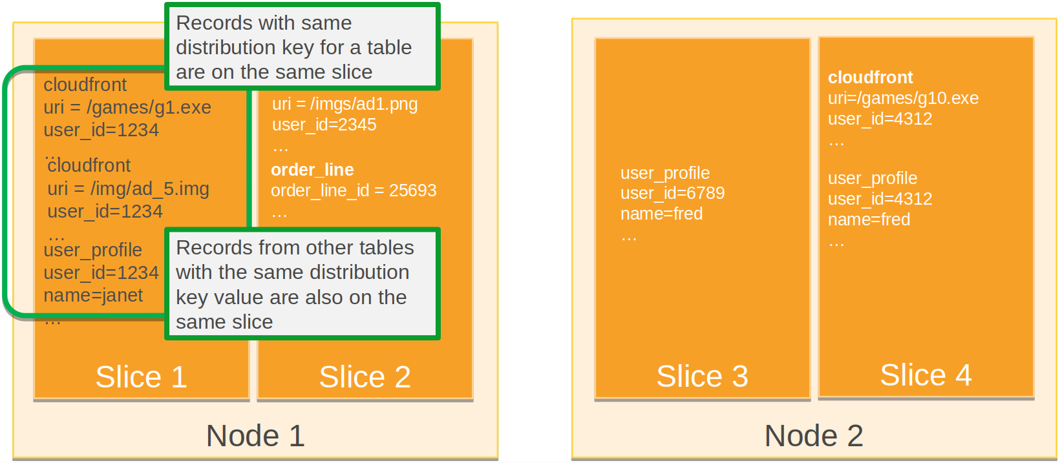
Distribution Key
Distribution key determines which data resides on which slices

Slide 14
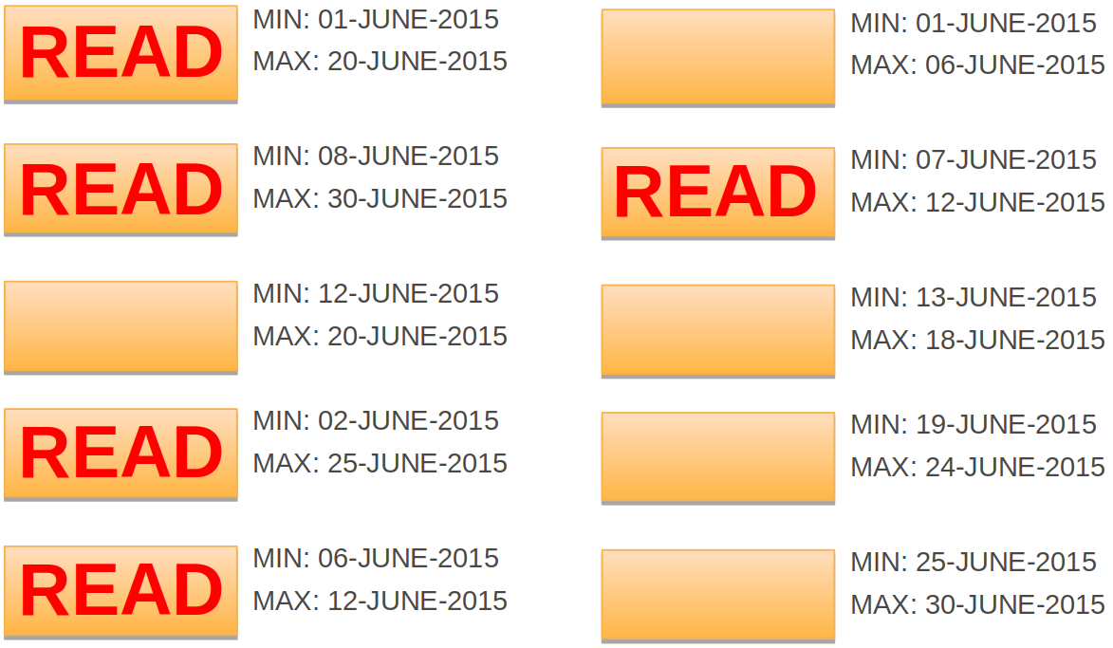
Sort Key
Unsorted table
Sortkey = DATE
SELECT COUNT(*) FROM LOGS WHERE DATE = ‘09-JUNE-2015’

Slide 15
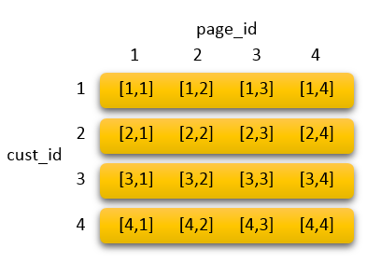
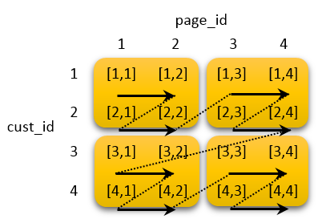
Sort Key - Multiple columns
Compound Key
Interleaved Key
Sorted by cust_id, then by page_id
(Use when cust_id always in filter)
Both columns have equal weight:
(Use when either could be independently used in filter)
Interleaved keys are SLOW to vacuum

Slide 16

Chores
VACUUM - Reclaims space and resorts rows in either a specified table or all tables in the current database.
ANALYZE - Updates table statistics for use by the query planner.

Slide 17
Backups
Snapshots
Automated snapshots occur every 8 hours or 5GB and retained for a configurable period
Snapshots are stored in S3 and can be stored on a different region than the cluster
Manual snapshots can be triggered
Can restore full snapshot to new cluster or restore single table to existing cluster
UNLOAD command
Query results can be exported to a file on S3

Slide 18
(Some) Interactive Clients
1
JetBrains DataGrip
2
SQL Workbench/J
3
Aginity Workbench
Pros
Amazing editor
Cross-platform (Java)
Cons
Commercial
No Redshift DDL support
Pros
Open Source
Cross-platform (Java)
Cons
Editor feels dated
No Redshift DDL support
Pros
Native Redshift support including DDL
Cons
Closed-source
Windows-only

Slide 19
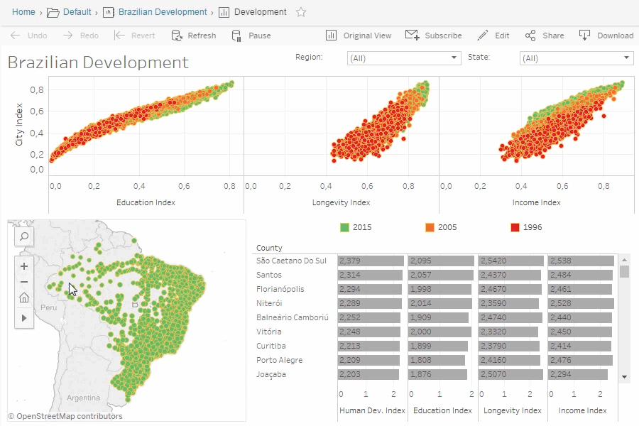
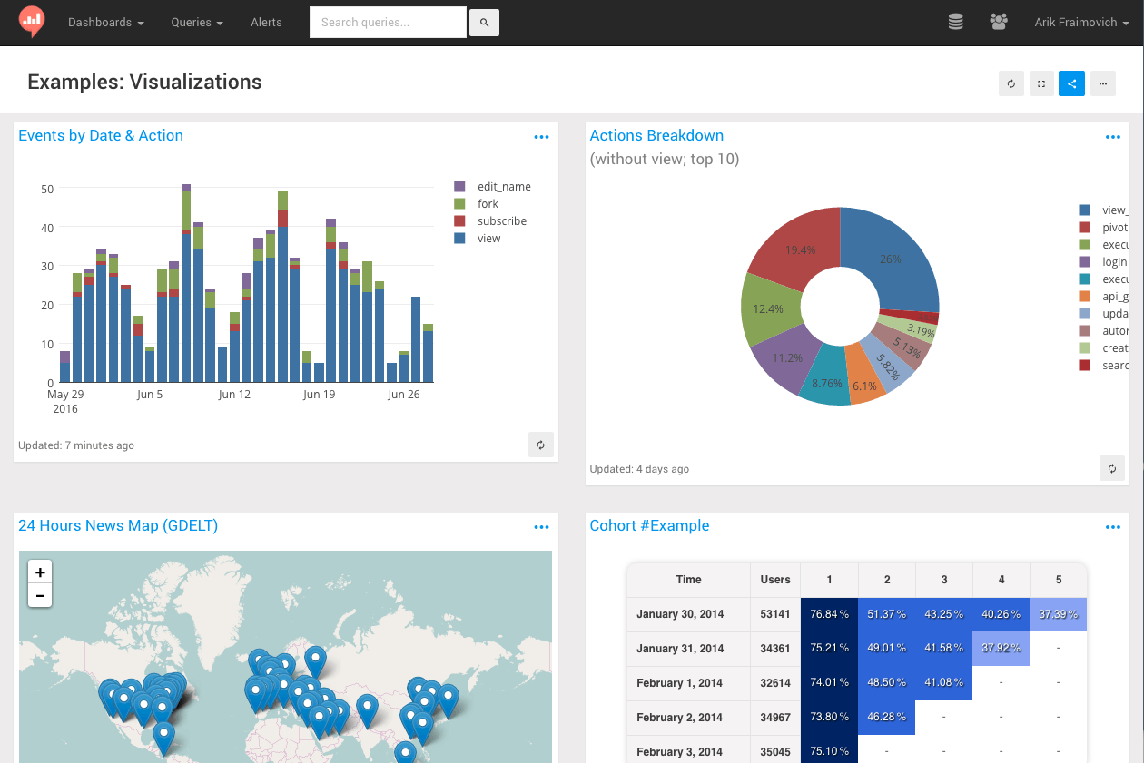
(Some) BI Tools with Native Support
Tableau
re:dash
(Open Source)
TONS more @ https://aws.amazon.com/redshift/partners/

Slide 20
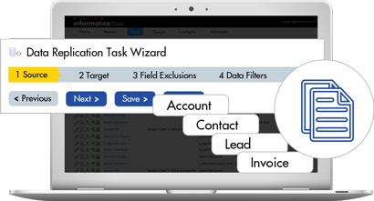
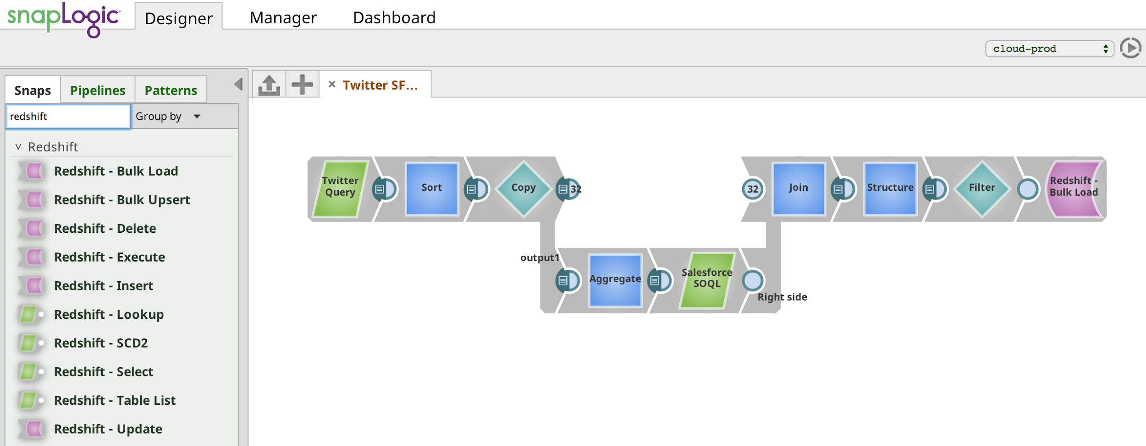
(Some) Data Integration Tools with Native Support
Informatica
SnapLogic
TONS more @ https://aws.amazon.com/redshift/partners/

Slide 21
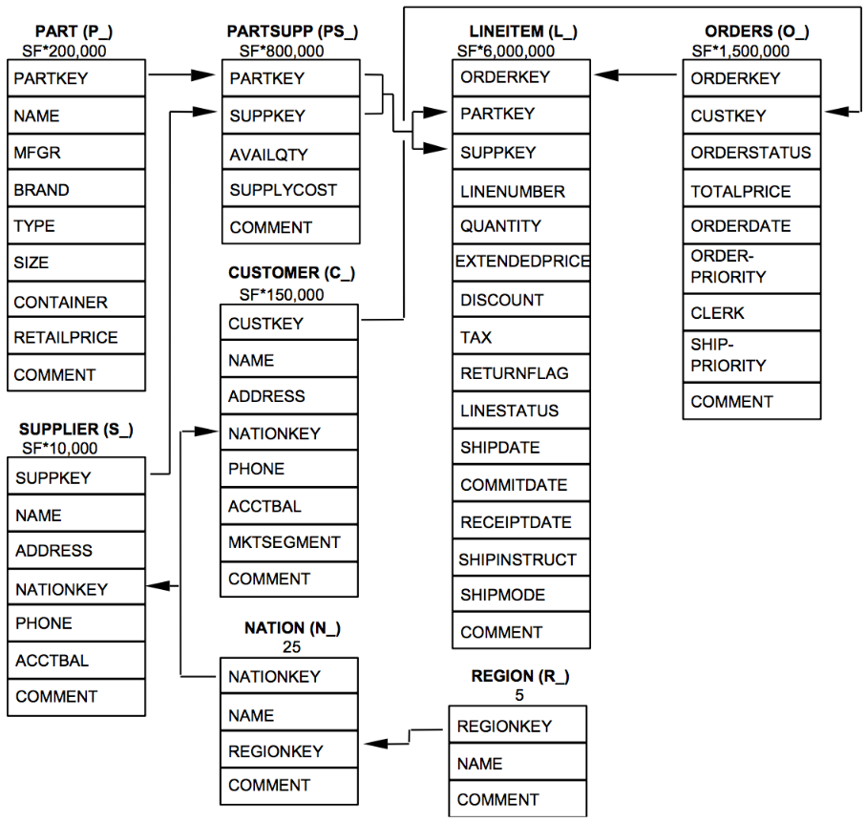
Normalized schema (TPC-H Benchmark)

Slide 22
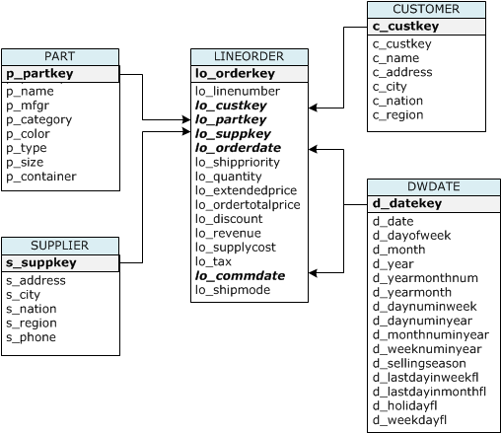
Star schema (Star Schema Benchmark)

Slide 23
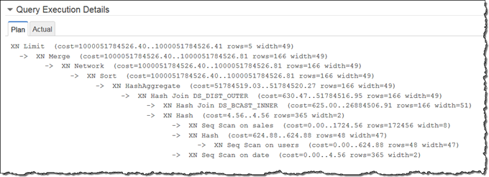
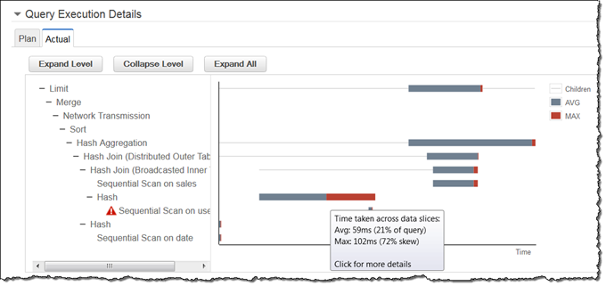
Performance Analysis
EXPLAIN command will display query execution plan
STL_EXPLAIN table stores execution plan for past queries
SVL_QUERY_REPORT view shows stats on queries already executed

Slide 24
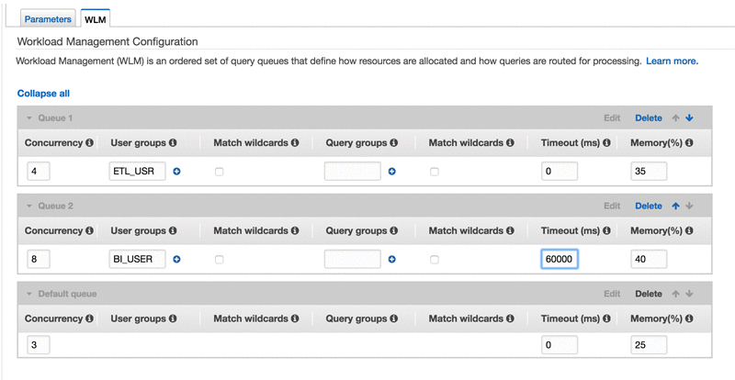
Workload Management

Slide 25
Redshift SQL Gotchas
Relational constraints (primary/foreign keys) are informational for query planning but aren’t enforced.
Don’t use views - duplicate the data instead. Filters not propagated down.
No control statements (IF/ELSE)
No secondary indexes
No stored procedures or triggers
User Defined Functions exist, but written in Python
Temp tables possible but slow to create and populate

Slide 26
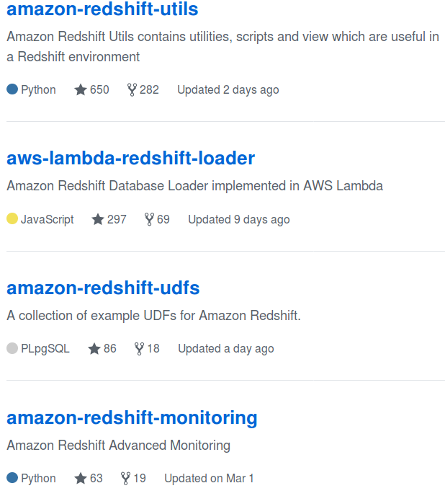
Tools
https://github.com/awslabs

Slide 27
References
https://aws.amazon.com/redshift/developer-resources/
https://aws.amazon.com/blogs/aws/quickly-filter-data-in-amazon-redshift-using-interleaved-sorting/
http://www.cs.umb.edu/~poneil/StarSchemaB.PDF
https://www.slideshare.net/AmazonWebServices/amazon-redshift-optimizing-performance-20150721
https://www.quora.com/What-is-the-difference-between-redshift-and-RDS

